Slide 1
GOPIKA R
Image Captioning using CNN and LSTM -Flickr8K
3/21/2024 Annual Review

Slide 2
PROJECT TITLE
Image Captioning using CNN and LSTM-Flickr8K
3/21/2024 Annual Review

Slide 3

AGENDA
Problem Statement
Project Overview
Introduction
End Users
Solution and Value Proposition
The Wow in Your Solution
Key Features
Modelling
Results
Conclusion
3/21/2024 Annual Review

Slide 4

PROBLEM STATEMENT
Generating accurate and relevant captions for images is a challenging task in computer vision.
The goal is to develop a system that can automatically generate captions for images, improving accessibility and understanding of visual content.
Existing approaches often struggle to produce captions that capture the essence of visual content effectively.
Challenges include understanding the semantics of images, translating visual features into coherent language, and maintaining relevance and coherence in generated captions.
Additionally, ensuring that generated captions are diverse, descriptive, and grammatically correct poses further challenges.

Slide 5

PROJECT OVERVIEW
The project focuses on developing an automated system capable of generating descriptive captions for images.
Leveraging deep learning techniques, the system combines Convolutional Neural Networks (CNNs) and Long Short-Term Memory (LSTM) networks to understand visual content and produce captions.
The model is trained on the Flickr8K dataset, which contains images along with corresponding textual descriptions.

Slide 6

WHO ARE THE END USERS?
1. Content Creators:
Bloggers, journalists, social media influencers, and marketers who rely on visual content for storytelling.
The image caption generator can assist them in quickly and efficiently adding descriptive captions to their images, enhancing accessibility.
2.Researchers:
Researchers in the fields of computer vision, natural language processing, and multimodal learning.
The image caption generator serves as a valuable tool for studying and advancing techniques in understanding and generating textual descriptions from visual content.
3. General Users:
Anyone who consumes visual content on digital platforms.
The generated captions enhance the user experience by providing additional context and information about images, enriching the overall browsing experience.

Slide 7

YOUR SOLUTION AND ITS VALUE PROPOSITION
Solution: Image Caption Generator using CNN and LSTM
Value Proposition:
Efficiency: Our solution automates the process of generating descriptive captions for images, saving time and effort for content creators.
Accessibility: Provides valuable context and information about visual content, enhancing accessibility for visually impaired individuals.
Enhanced Engagement: Captions add depth and storytelling elements to images, increasing engagement and interaction with visual content.
Versatility: The image caption generator can be integrated into various applications and platforms, catering to diverse user needs.

Slide 8

THE WOW IN YOUR SOLUTION
Integration of CNNs and LSTMs: This integration enables the model to understand visual content and generate contextually relevant captions.
Pretrained GloVe Embeddings: We incorporate pre-trained GloVe word embeddings to enhance the semantic understanding of textual descriptions. This improves the model's ability to generate captions that are not only descriptive but also semantically meaningful.
The Wow Factor:
Our solution stands out due to its robust architecture, seamless integration of deep learning techniques, and user-friendly interface.
It offers an efficient and effective way to generate descriptive captions for images, catering to the diverse needs of users across different domains.
3/21/2024 Annual Review
8

Slide 9
MODELLING
CNN-LSTM Architecture:
Combines Convolutional Neural Networks (CNNs) for image feature extraction and Long Short-Term Memory (LSTM) networks for sequence modeling.
CNN extracts visual features from images, while LSTM generates captions based on these features.
Embeddings Integration:
Integrates pre-trained GloVe word embeddings to enhance the semantic understanding of textual descriptions.
Embeddings are used to represent words in the vocabulary, improving the model's language understanding.
9

Slide 10
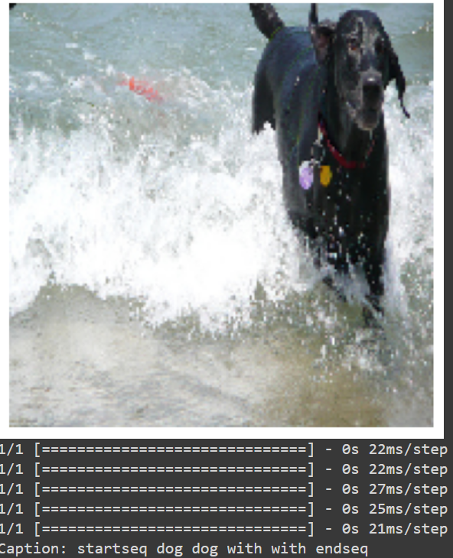
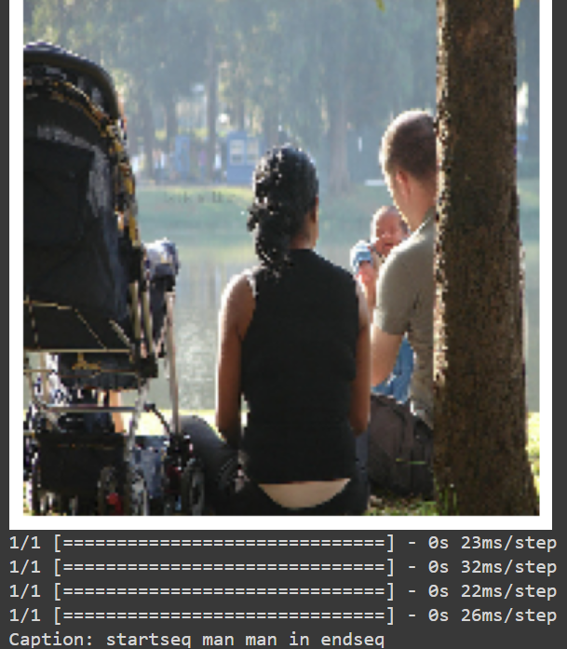
RESULTS
https://github.com/gopika173/Naan-Mudhalvan_GenAI
10

Slide 11
CONCLUSION
In conclusion, the Image Caption Generator employing CNNs and LSTMs offers an efficient and effective solution for automatically generating descriptive captions for images. By integrating deep learning techniques and pretrained GloVe embeddings, it achieves contextually relevant and semantically meaningful captions. With its ability to cater to diverse user needs, enhance accessibility, and add storytelling elements to visual content, this solution holds great potential for revolutionizing the way images are understood and consumed across various domains.

